Slide 1
Financial and Accounting Analytics of Stock Returns (Market Shock in Early 2022)
Chris Chang

Slide 2
TABLE OF CONTENTS
01
02
03
Risk Exposures
Financial Ratios
Industry Indicators
04
05
06
Regression
Summary
Recommendation

Slide 3
01 Risk Exposure

Slide 4
Data Processing
STEP 1
STEP 3
STEP 2
STEP 4
Modified ‘RET’ column to float in Returns.csv
Fill in missing values with Median in ‘RET’
Match unique tickers (1925 -> 1886 rows)
Winsorized outliers
Notes:
There were around 114715 observations in the returns from 2017 - 2021
Found that RET column was an object so I modified that to float
In the returns csv there were 1925 unique tickers so i merged tickers csv (1886 unique) to returns on a left join to get 1886 unique tickers
11 missing RET values in returns so I filled in with median
Checked for outliers by describe and boxplots then winsorized the data

Slide 5
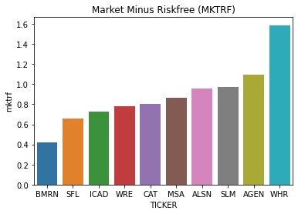
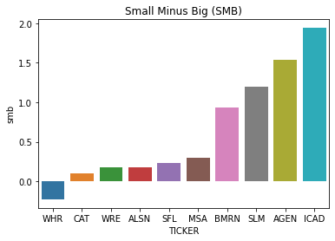
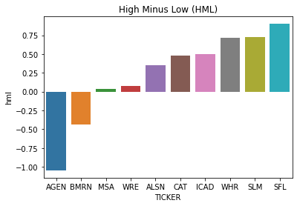

Fama-French Pricing Model Factors
Market Risk Factor
Small Minus Big
High Minus Low
𝛃 > 1 : Stock > Market (Volatility)
𝛃 = 1 : Stock = Market (Volatility)
𝛃 < 1 : Stock < Market (Volatility)
𝛃 > 0 : Small Stock > Big Stock
𝛃 = 0 : Small Stock = Big Stock
𝛃 < 0 : Small Stock < Big Stock
𝛃 > 0 : High value > Small Value
𝛃 = 0 : High value = Small Value
𝛃 < 0 : High value < Small Value
Notes:
Let’s take a look at WHR (American multinational manufacturer and marketer of home appliances headquartered in Michigan)
Mktrf -> stock is 60 percent more volatile than market
Sml -> negative so big cap stock
Hml -> growth stock

Slide 6
02 Financial Ratios

Slide 7
Data Processing and Ratios
Step 1
Step 2
Step 3
Step 4
Sample Size
Missing Values
Outliers
Ratios
1886 Observations
Replaced total liabilities (5 missing) with median and dropped current assets and liabilities (> 400 missing each)
Winsorized Outliers
Earnings-Price Ratio
Sales-Price Ratio
EBIT-Price Ratio
Book-Price Ratio
ROA/ROE
Earnings-Share
Debt Ratio
Debt-Equity Ratio
Net-Profit-Margin

Slide 8
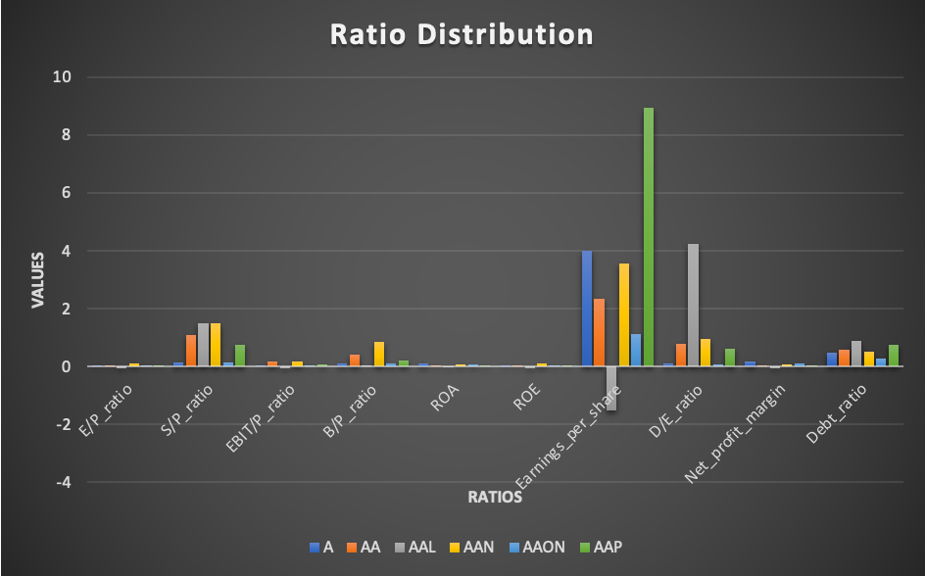
Financial Ratios Distribution

Slide 9
03 Industry
Indicators

Slide 10
Data Processing
Sample Size
Missing Value
Sector data: 1886
No missing

Slide 11
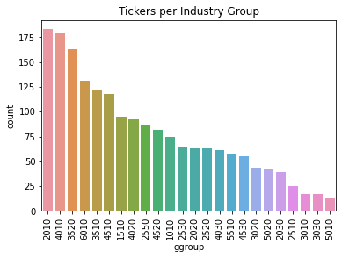
Tickers Per Industry Group
Top 3 Industries:
2010 - Capital Goods
4010 - Banks
3520 - Pharmaceuticals, Biotech, and Life Sciences
Notes:
Top three groups
2010 - Capital Goods (Electrical Equipment/Machinery)
4010 - Banks
3520 - Pharmaceuticals, Biotechnology & Life Sciences

Slide 12
04 Regression

Slide 13
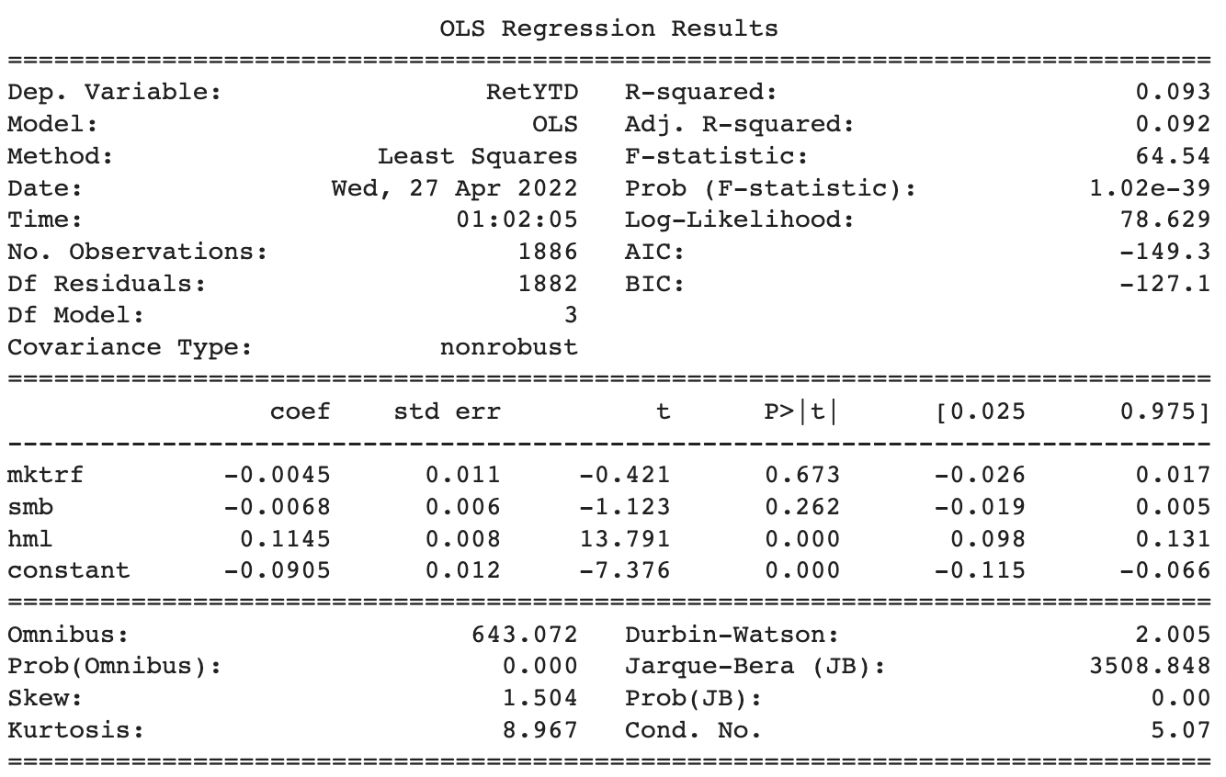
Risk Factors

Slide 14
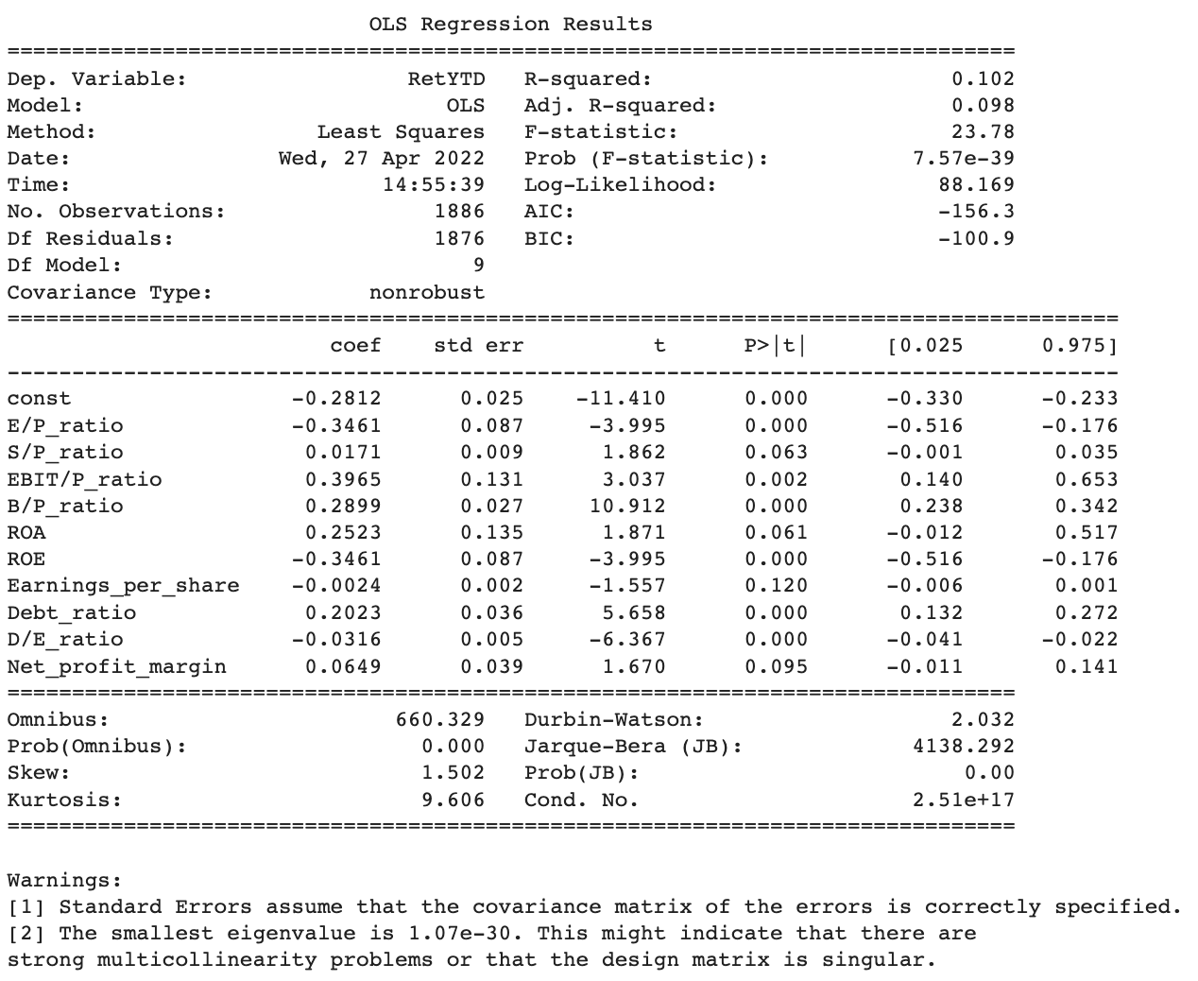
Financial Ratios

Slide 15
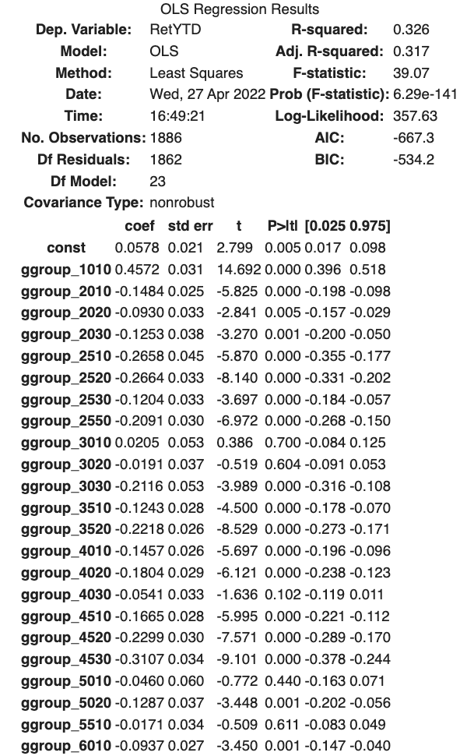
Industry Indicators
Highest Return - Group 1010 (Energy)
Lowest Return -
Group 4530 (Semiconductors)
Dropped group 1510 - Materials (Chemicals/Construction materials etc.)
Notes:
1010 energy has highest RET
4530 has lowest RET

Slide 16
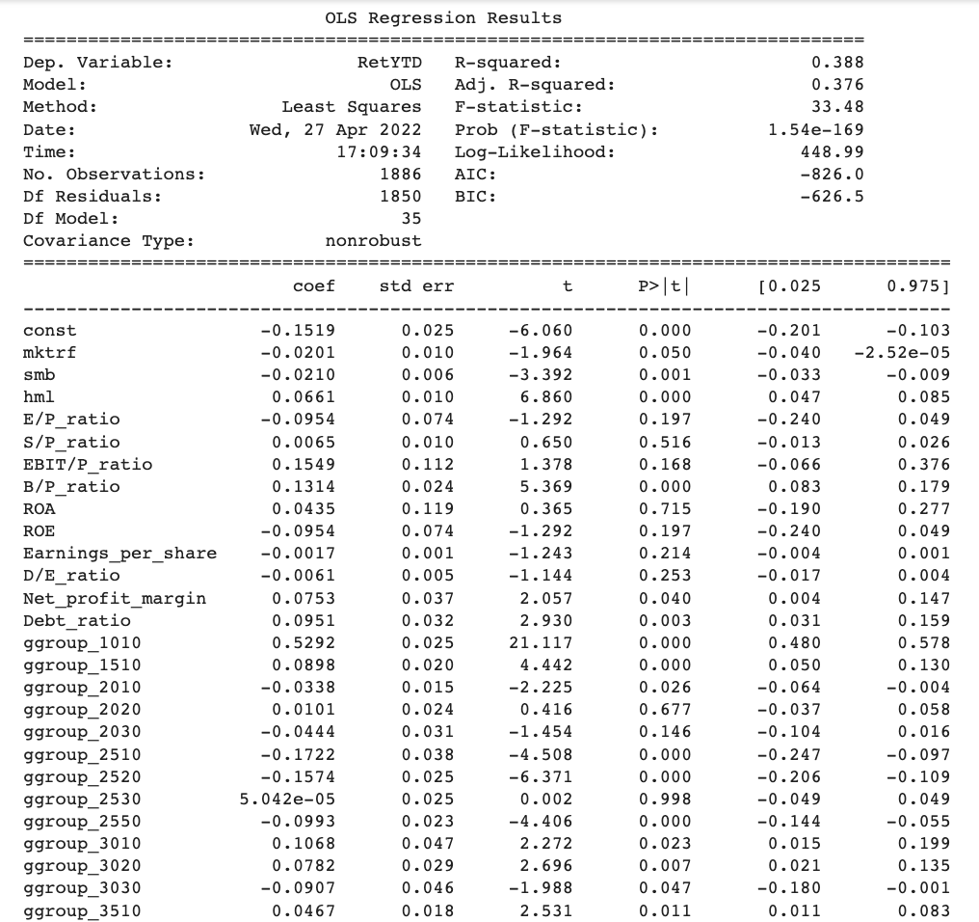
Combined Regression

Slide 17
05/06 Summary & Recommendation

Slide 18
Conclusion
Summary
Recommendation
In this project I did analysis on stock returns during the early 2022 market shock using three kinds of indicators: Risk factors, Financial ratios, and Industry groups. Results from regression indicate that industry indicators perform best when it comes to explaining stock returns, with the highest adjusted r-squared among the three. Furthermore, R-squared increased after combining all three indicators.
Based on the models, it is plausible to say that one should:
Not put all eggs in one basket. - DIVERSIFY!
Use Earnings/Price, EBIT/Price, Book/Price, ROE, Debt, Debt/Equity financial ratios to evaluate stock returns for companies.

Slide 19
END OF PRESENTATION, THANKS!

